Slide 1
Large-Scale and Multi-Structured Databases Project Design The 64th Square
Gabriele di Lonardo, Andrea Gennari, Andrea Innocenti

Slide 2
Application Highlights
The application must:
Provide a registration system for new users.
Show statistics about chess matches, players and about relations among players.
Provide a matchmaking system for the players.
Provide the possibility to schedule tournaments.
Manage friendship relations among players.
L’app è un social di giocatori, una sorta di blog, dove possono consultare le stats delle partite e caricare le proprie (che sono fatte per cazzi loro)
Potremmo pensare anche ad una lista di reviews che I giocatori lasciano alle partite altrui. Idea: è il singolo giocatore che carica I dati della propria partita! Ovviamente può anche non caricare tutte le mosse.-> va bene tanto non c’è uno schema fisso in mongo

Slide 3
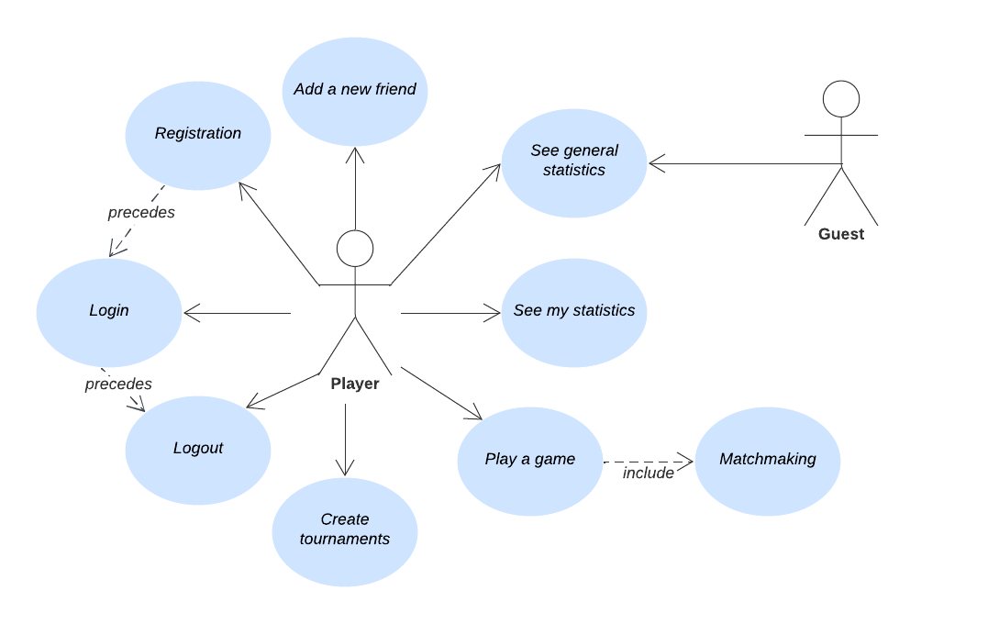
Actors and main mock-ups

Slide 4
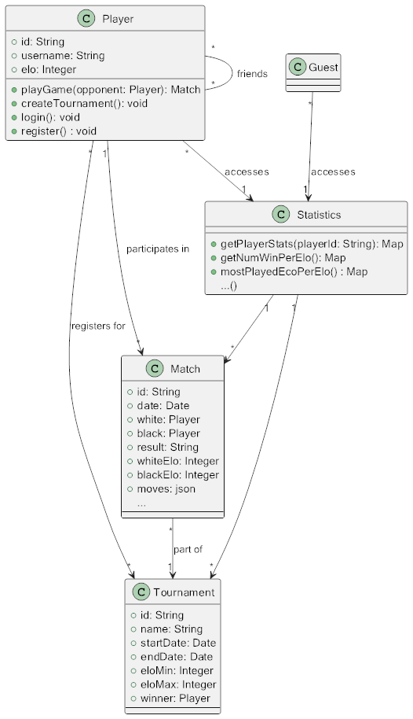
Preliminary UML Class Diagram

Slide 5
Relevant Queries and Entities handled by Document DB
On Matches collection:
Most used opening per Elo range (0-1000, 1000-1500, 1500-2000, more than 2000). In particular both players must have the Elo in the specified range.
Number of wins/losses/draws per Elo range.
Opening with higher win rate.
The player who has the widest repertoire of openings.

Slide 6
Relevant Queries and Entities handled by Document DB
On Players collection:
A player’s Elo trend over time.

Slide 7
Relevant Queries and Entities handled by Graph DB
The player within a certain (current) Elo range by exploring the “played with” relationship to some depth in order to provide the matchmaking.
Misura di influenza di un giocatore.
Giocatore con cui ho giocato a cui posso arrivare tramite una rete di amici
Distanza tra 2
The average Elo of your friends. – questa no

Slide 8
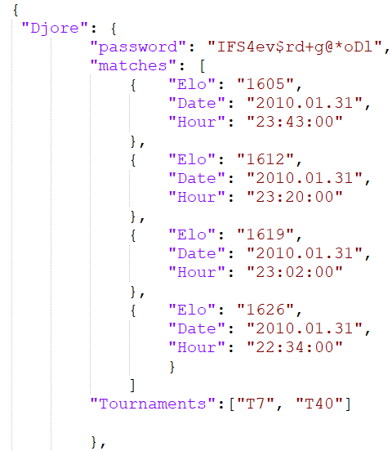
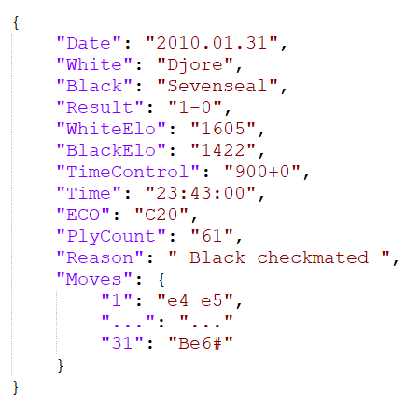
Relevant Queries and Entities handled by Document DB
Document of the collection Players
Document of the collection Matches

Slide 9
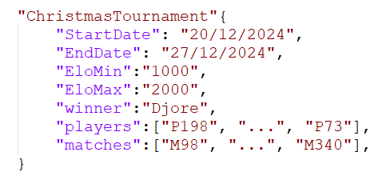
Relevant Queries and Entities handled by Document DB
Document of the collection Tournaments

Slide 10
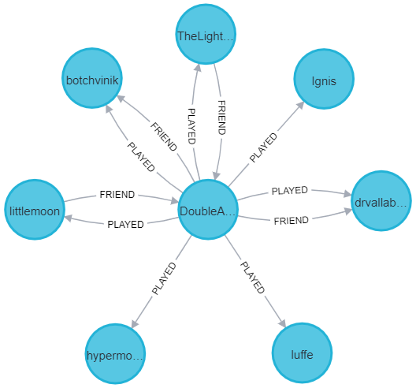
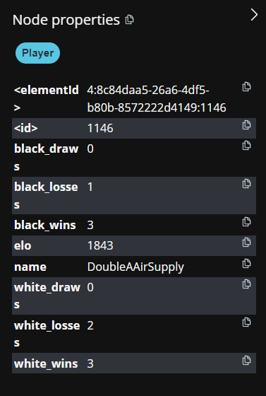
Relevant Queries and Entities handled by Graph DB

Slide 11
Dataset Description
Source: ficsgames.org + Lichess.org.
Description: it contains thousand of chess matches and more than ca. 12000 players with different Elo (the player rating). In particular:
from ficsgames.com, all chess matches played on FICS platform January 2010.
from Lichess.org some matches are taken, used to simulate matches among real players registered inside the application.
Volume: more than 100MB.
Variety: the dataset is the union of data from ficsgame.org and Lichess.org.
Variability: there is the possibility to upload new matches to the dataset and to discard the old ones.

